Slide 1
Web App Usage Instructions
T-DEVS

Slide 2
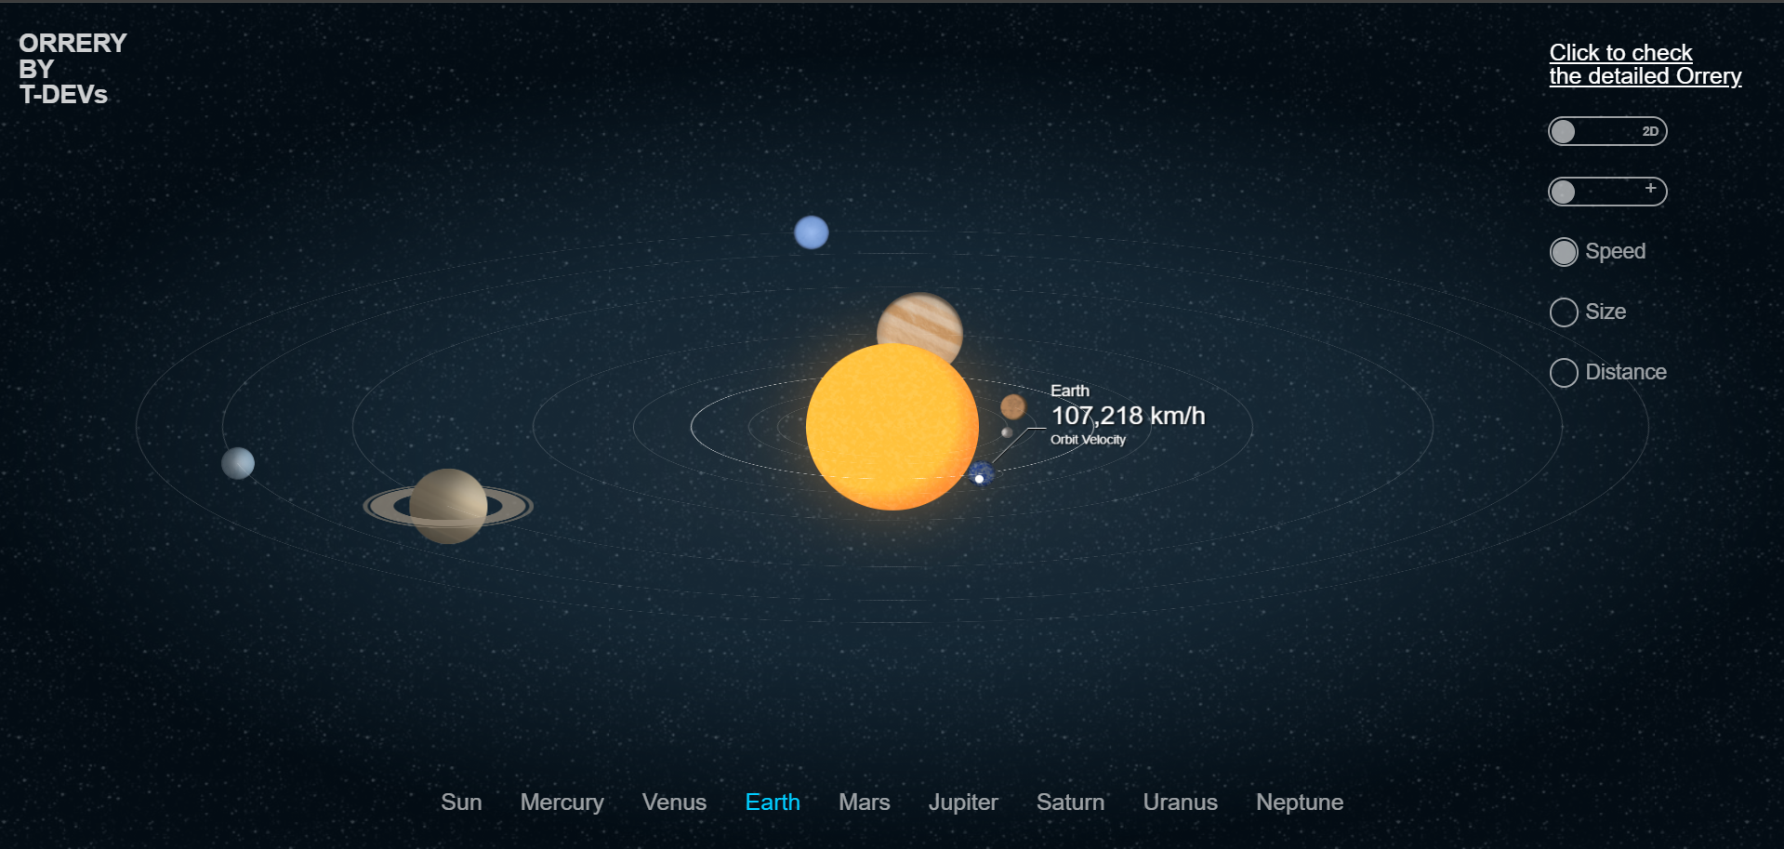
Detailed orrery
Navigations
Simple Interaction menu

Slide 3
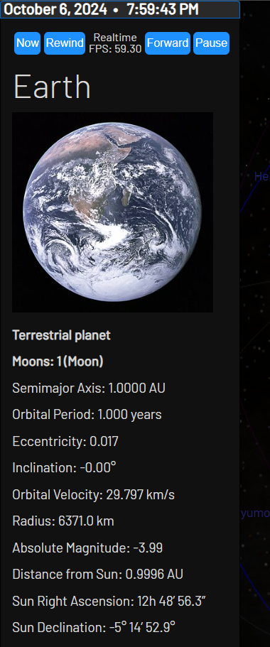
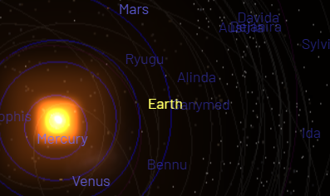
Parameter Adjustment
Main Screen
Details panel

